Slide 1

Sales Volume Forecasting with
Data Bender App
Project Team 1 (RMT-025 FTDS)
Aumedi . W - Data Engineer & Data Scientist
David . J - Data Analyst
Rahma . W - Data Scientist

Slide 2

Data Bender
Sales Volume Forecasting
Forecasting production volumes is a critical aspect of business planning and operations management. By accurately predicting the demand for our products, we can optimize our production processes, manage inventory levels efficiently, and make informed decisions about resource allocation.
One effective method for forecasting production volumes is by utilizing sales values.
In this project, we focused on improving the inventory planning process of our client company in Q1 2024. This company acts as a product distributor by purchasing office products from manufacturers, holding them and then reselling them to retailers and end-users.

Slide 3

Data Bender
Project Background
By analyzing our client’s office products purchases, sales and product details data, we created a web-app named Data Beder to makes predictions of predicted sales quantities. Knowing how much will be sold of each product category in the future can help determine how much of each product category should be ordered or kept in stock at any given time.
Notes:
Fauzan slide 2 - 5

Slide 4
Timeline Project
Stakeholders Meeting
Discusses user requirements and business understanding.
Day - 2
9 January 2024
Modeling & Evaluation
Conduct Model experiments and model evaluation. Meeting team.
Day - 4
11 January 2024
Day - 1
8 January 2024
Exploratory Data Analysis
ETL, Analyze product and sales data, Modeling. Meeting team.
Day - 3
10 January 2024
Deployment & Reporting
Make a deployment of the model that has been created and report the results to stakeholders.

Slide 5
Data Exploratory
We’ll go to the dashboard for EDA
Notes:
Dwita

Slide 6
Sales Volume Forecasting
Method
Data Sources
The data used for this project comes in the form of CSV files obtained from Github.
The CSVs contain 5-years worth of data (2018 to 2022) for Sales and Product Details
Model Forecasting
For predicting future sales volumes, we will comparing three models, SARIMA, LSTM, and Linear Rgression then we will choose one model with the best evaluation result and deploy it in to web app.

Slide 7
Results
Matrics Evaluation
Forecasting Q1 2024
MODEL | MAPE
SARIMA | 12.28 %
LSTM | 15.96 %
Linear Regression | 10.71 %
Date | Prediction Ship Quantity
January 2024 | 2326 products
Feburary 2024 | 2402 products
March 2024 | 2426 products
April 2024 | 2332 products

Slide 8
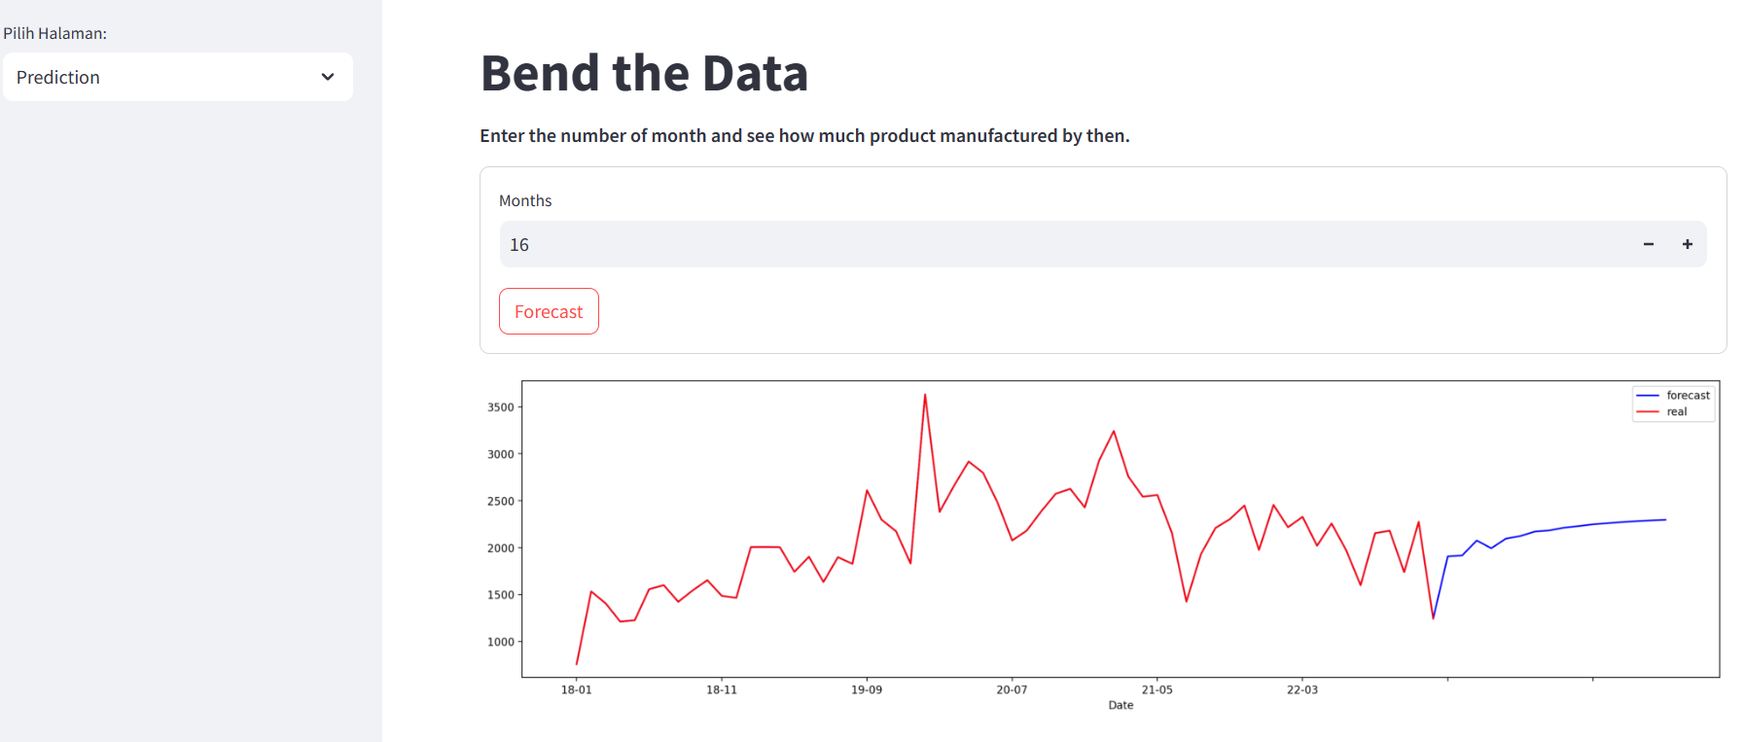
Deployment
The model is deployed using Hugging Face
Notes:
Ardi slide 7-9

Slide 9
Data Bender
Challenges
Trial and Error Model Experiments
Model experiments process using 3 models with several hyper parameter tunning is quite time consuming. Therefore, in this project we assigned two people to get role of data scientist.
Monthly Forecasting
Mostly timeseries forecasting with a (year-month-date) datetime format, in this case we use data in stringtime format to predict based on month (year-month).
Deployment Dependency Error
Due to we share the task to deploy EDA for Data analyst and Prediction for Data Scienctist, when we merge our sourcecode there is error dependency.

Slide 10
Data Bender
Success Story
Not only using a timeseries forecasting model, but we are trying to create a forecasting model using machine learning and deep learning. And we are able to complete the modeling process within a limited time.
We ere able to minimize errors from 20% to 10% by understanding the window concept in hyperparameter tuning for forcaseting models.
We were able to implement our data science skills to be useful in increasing company profits, and we created a data bender web app, so there are more users can use our application more easily.

Slide 11
Data Bender
Conclusion & Business Impact
We successfully predict the ship quantity in Q1 2024.
January 2024 = 2326 products
Feburary 2024 = 2402 products
March 2024 = 2426 products
April 2024 = 2332 products
From three models : SARIMA, LSTM, Linear Regression, the best model is Linear Regression with 10% the value of evaluation result using MAPE.
Further Developments:
We suggest to doing more experiment actually in LSTM Layer Model, because LSTM are capable of learning and capturing complex patterns and dependencies within the data, which can make them effective for predicting non-stationary time series.
We also recommend to make forecasting for each category. So the company get more insight about the detile prediction.
Notes:
Dwita

Slide 12




Thank You
Aumedi
FTDS-RMT-025
Data Engineer & Scientist
0853 2058 6294
aumedi1subagya@gmail.com
David
FTDS-RMT-025
Data Analyst
0851 6262 2197
Rahma W.
FTDS-RMT-025
Data Scientist
0858 9404 1489
swaraombak@gmail.com
Hacktiv8id
Hacktiv8id
Hacktiv8
Hacktiv8 Indonesia
Notes:
Ardi closing

